Slide 1
story 5
File created on: 10/28/2023 3:36:09 PM

Slide 2
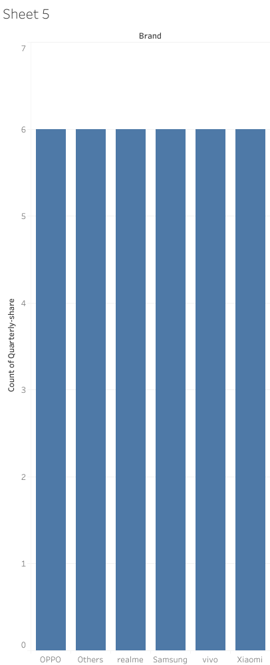

Slide 3
